Slide 1
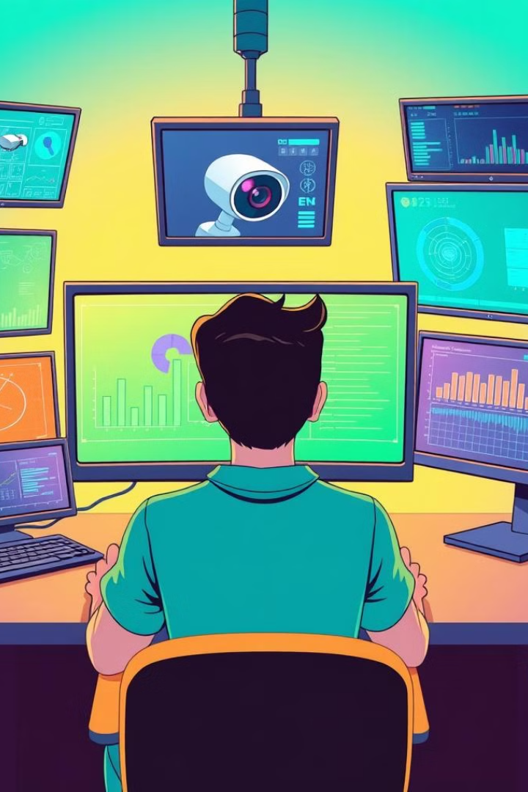

Displaying Live IP Camera Feed Using Python
This presentation explores how to access and display live video streams from IP cameras using Python, with a focus on basic image processing techniques and essential libraries.
by Anand Prajapati

Slide 2
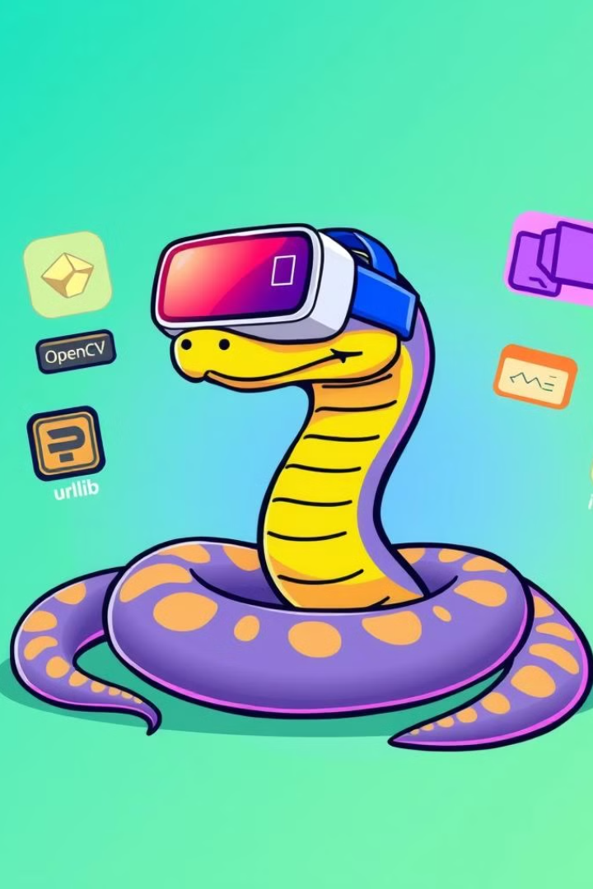
Introduction
1
Objective
2
Technologies
Learn how to access and display a live video feed from an IP camera using Python.
We'll utilize OpenCV for image processing, urllib for fetching the image data, and imutils for resizing the image.

Slide 3

Code Overview
1
Fetch Image
Retrieve a snapshot (JPEG) from the IP camera's URL.
2
Decode Image
Convert the byte stream into an OpenCV-compatible format for processing.
3
Display Image
Continuously show the image in a window for visualization.
4
Exit Program
Close the feed when the user presses the 'q' key.

Slide 4

Step 1 – Import Libraries
Library
Purpose
urllib.request
Fetches the image from the camera's URL.
cv2
Handles OpenCV functions, such as image decoding and display.
numpy
Manages image data in a numerical format.
imutils
Resizes images for optimal display.

Slide 5
Step 2 – Accessing and Decoding the Image
URL
Fetching the Image
Decoding the Image
The IP camera's URL that hosts the image stream (e.g., `http://10.183.188.158:8080/shot.jpg`).
Use `urllib.request.urlopen(url)` to retrieve the image data as a byte stream.
Employ `cv2.imdecode(imgnp, -1)` to decode the byte stream into an OpenCV-compatible image format.

Slide 6
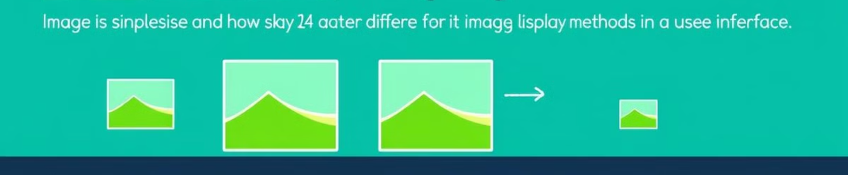


Step 3 – Resizing and Displaying the Image
Resizing the Image
Displaying the Image
Use `imutils.resize(img, width=450)` to resize the image to a desired width for better visualization.
Employ `cv2.imshow("CameraFeed", img)` to display the image in a window titled "CameraFeed".

Slide 7
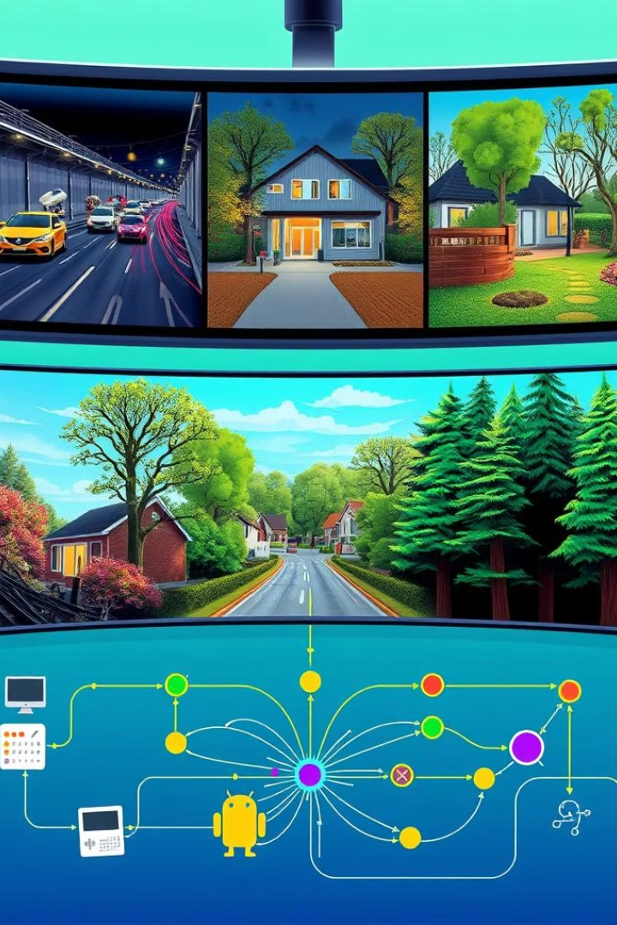

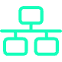
Applications & Conclusion
Security Monitoring
IoT Projects
Live feeds from IP cameras can be used for real-time security monitoring, allowing you to observe and react to events in a timely manner.
Integrate live camera streams into your Python-based IoT systems for enhanced functionality, such as remote monitoring and control.

